Slide 1

IMAGE DEBLURRING
Date: 27 May 2021
S.SIRISHA : 17WH1A0582
K.SAI SINDHU : 17WH1A0593
S.SREEYA : 17WH1A05B7 Internal Guide: Ms. E.G. Padmavati
Designation : Assistant Professor
Department of Computer Science and Engineering

Slide 2

Abstract
Why Should I Study this course?
Examples
This project aims to recover the clear image solely from an input blurry image, is a
challenging ill-posed problem. This is done using a novel ranking convolutional neural network (Ranking-CNN). In Ranking-CNN, a novel ranking layer is proposed to extend the structure of CNN so that the statistical and structural attributes of blurry images can be simultaneously captured. By training Ranking-CNN in a well-designed manner, powerful blur-relevant features can be automatically learned from massive blurry image patches.
Based on these features, blur can be effectively removed by using a blur density prediction model trained through the random forest regression.
BVRIT HYDERABAD College of Engineering for Women

Slide 3
Dataset
Why Should I Study this course?
Syn Dataset (Synthetic dataset of Low Fidelity Images) which consists of 27000 blur images generated from 1000 clear images.
https://www.kaggle.com/vinothpandian/syn-dataset?select=images.tar
Examples
BVRIT HYDERABAD College of Engineering for Women

Slide 4
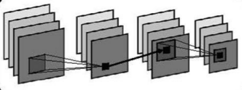
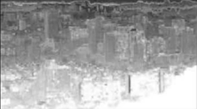
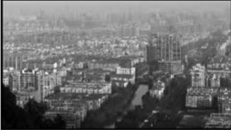
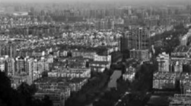
Architecture
Why Should I Study this course?
Ranking - CNN
Estimated Transmission
Examples
Random
forest Regression
Blur
relevant
features
Image Deblurring
Blur Image
Clear Image
BVRIT HYDERABAD College of Engineering for Women

Slide 5
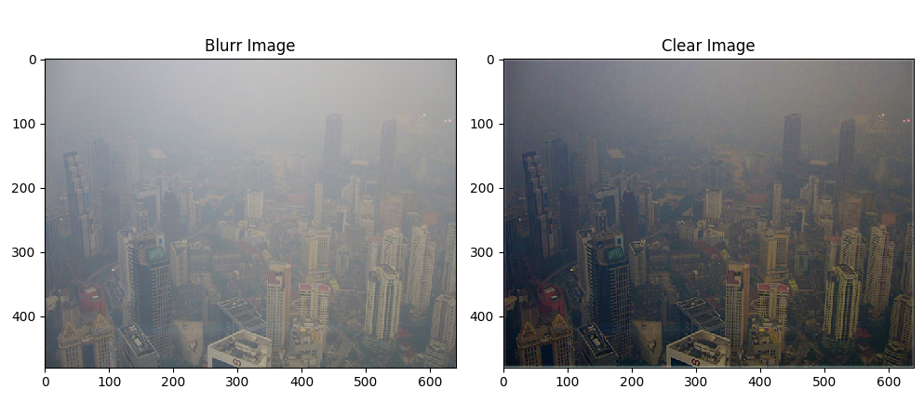
Output
Why Should I Study this course?
Examples
BVRIT HYDERABAD College of Engineering for Women

Slide 6
Technology Stack
Why Should I Study this course?
Programming language : Python
Libraries Needed : Numpy, Tkinter, Matplotlib, Tensorflow
Examples
BVRIT HYDERABAD College of Engineering for Women

Slide 7
References
Why Should I Study this course?
[1] Mahdi S. Hosseini, and Konstantinos N. Plataniotis “Convolutional Deblurring for Natural Imaging” (Base paper).
[2] J. Sun, W. Cao, Z. Xu, and J. Ponce, “Learning a convolutional neural network for non-uniform motion blur removal,” in Proc. CVPR, 2015, pp. 769–777.
[3] S. M. C. Nascimento, K. Amano, and D. H. Foster, “Spatial distributions of local illumination color in natural scenes,” Vis. Res., vol. 120, pp. 39–44, Mar. 2016.
[4] W. Ren, S. Liu, H. Zhang, J. Pan, X. Cao, and M.-H. Yang, “Single image dehazing via multi-scale convolutional neural networks,” in Proc. Eur. Conf. Comput. Vis. Amsterdam, The Netherlands: Springer, 2016, pp. 154–169.
Examples
BVRIT HYDERABAD College of Engineering for Women

Slide 8
Why Should I Study this course?
Thank you
Examples
BVRIT HYDERABAD College of Engineering for Women

